Slide 1
IT TICKET ANALYSIS
- SAKETH REDDY

Slide 2
Agenda
Problem Statement
Data Description
Objective Key Metrics and Visualizations
Insights and Recommendations

Slide 3
Problem Statement
The objective is to analyse the IT support ticket management system to understand the performance of IT agents, the efficiency of ticket resolution, and the satisfaction levels of employees. The analysis aims to identify high and low performers among IT agents, assess the overall effectiveness of the team, and pinpoint areas for improvement in the ticket resolution process. The ultimate goal is to make informed staffing decisions, including hiring, firing, and training, to enhance overall service quality and team performance

Slide 4
Data Overview
Priority: Priority level of the issue.
Resolution Time (Days): Time taken to resolve the ticket.
Satisfaction Rate: Satisfaction rate provided by the employee (1-5 scale).
IT Agents Sheet: Contains information about IT agents.
Agent ID: Unique identifier for the agent.
Full Name: Full name of the agent.
Email: Email address of the agent.
Year of Birth: Year the agent was born.
Month of Birth: Month the agent was born.
Day of Birth: Day the agent was born.
Tickets Sheet: Contains information about IT support tickets.
ID: Unique identifier for the ticket.
Ticket Fetcha : Date of the ticket.
Employee ID: ID of the employee who raised the ticket.
Agent ID: ID of the agent assigned to the ticket.
Request Category: Category of the request (e.g., Login Access, System, Software).
Issue Type: Type of issue (e.g., IT Error, IT Request).
Severity: Severity of the issue.
Priority: Priority level of the issue.

Slide 5
This tracks the total number of tickets created each year.
It helps in understanding year-over-year trends and analysing ticket volumes over long periods.
Analysis
The chart highlights a steady year-over-year increase in ticket volume, with a notable surge between 2019 and 2020, suggesting accelerating growth due to expanding operations, rising demand, or improved reporting.

Slide 6
Tickets are grouped into predefined categories such as Hardware, Login Access, Software, and System, and the count is determined for each.
This shows which category generates the highest or lowest number of requests, allowing for better resource allocation.
Analysis
System-related tickets make up the largest share (40%), indicating the highest resource demand, while Hardware issues (10%) require the least, helping guide efficient resource allocation.

Slide 7
This measures customer satisfaction rates (e.g., 1-5) and tracks how they change over the years.
It’s useful for identifying long-term trends in customer experience.
Analysis
Customer satisfaction has steadily improved from 4.0 in 2016 to 4.2 in 2020, reflecting a positive trend that could be sustained or accelerated for greater impact.

Slide 8
This analyses satisfaction rates across different agent age groups (e.g., 28–31, 32–35, etc.).
It identifies how satisfaction levels differ based on demographic factors.
Analysis
The 52–55 age group has the highest satisfaction (4.4), while the 40–43 group reports the lowest (3.9), suggesting varying expectations across age demographics.

Slide 9
This metric looks at how tickets are distributed across different customer satisfaction rates.
For example, tickets may be grouped by satisfaction scores (e.g., 1–5), showing the proportion of satisfied vs. dissatisfied customers.
Analysis
With 50,770 tickets at a satisfaction score of 5 and 27,562 at 4, the data shows a strong majority of positive feedback, while lower scores (2 and 3) indicate relatively few dissatisfied customers.

Slide 10
The chart shows the average resolution time for different request categories (Hardware, Login Access, Software, and System) across four quarters.
It provides a periodic view of resolution efficiency.
Analysis
Hardware has the longest resolution time (~7.5–7.7 hours), while Login Access is the fastest (~0.3 hours), with Software (~5.2–5.3) and System (~6.6) showing stable resolution times.

Slide 11
This groups tickets based on their severity (e.g., 0, 1, 2, 3, 4) and provides the total count for each category.
It highlights the proportion of tickets with varying levels of urgency.
Analysis
Severity 2 tickets are the most common (88,656), while severities 0 (356) and 4 (1,392) are rare, indicating most issues fall within mid-level urgency.

Slide 12
This categorizes tickets based on their assigned priority levels (e.g., 0, 1, 2, 3) and tracks the total count in each category.
It identifies the tickets requiring immediate attention.
Analysis
Priority 3 has the highest ticket count (35,549), indicating the greatest need for immediate attention, while priority 2 has the lowest (15,845).

Slide 13
This shows how efficiently tickets are resolved and highlights areas for process improvement.
Analysis
Most tickets (over 25,000) are resolved on the same day, highlighting strong efficiency, while peaks at 1, 5, and 6 days suggest areas for process improvement to reduce delays.

Slide 14
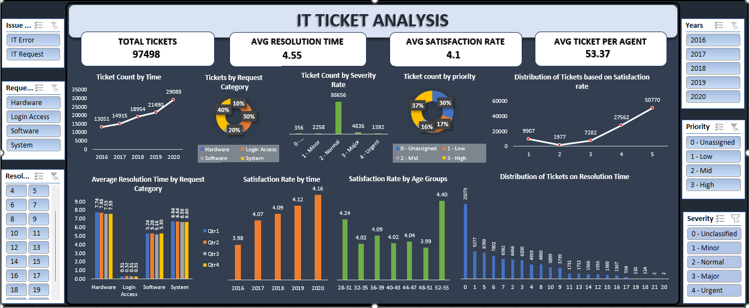
Dashboard

Slide 15
Conclusion
The analysis highlights rising ticket volumes, seasonal peaks, and variations in resolution times and satisfaction rates. While demand has grown, effective resource allocation and automation can help maintain service quality. Optimizing resolution times and training underperforming agents are crucial, as delays impact satisfaction.
Strategic staffing during peak periods (Q3 and Q4) and monitoring key metrics will drive continuous improvements, ensuring scalability, efficiency, and a better user experience.

Slide 16
Recommendations
To improve IT support, invest in automation tools and AI-driven ticketing systems to boost efficiency and reduce manual workload.
During peak periods (Q3 and Q4), allocate additional resources and provide targeted training to underperforming agents to maintain high service levels.
Optimize workload distribution and implement proactive support measures, such as self-service tools, to reduce ticket volumes.
Regularly track key metrics and adapt strategies based on trend analysis and user feedback for continuous improvement and scalability.

Slide 17
Thank you

